Slide 1
Untitled Snake Game
Have you ever thought that Pokemon Go would be better without all that AR stuff and a lot more snakes? Find snakes, collect them, look at them.
Roni Hevonkorpi, Minami Ogawa, Juha Pesonen, Chathura Yapa

Slide 2
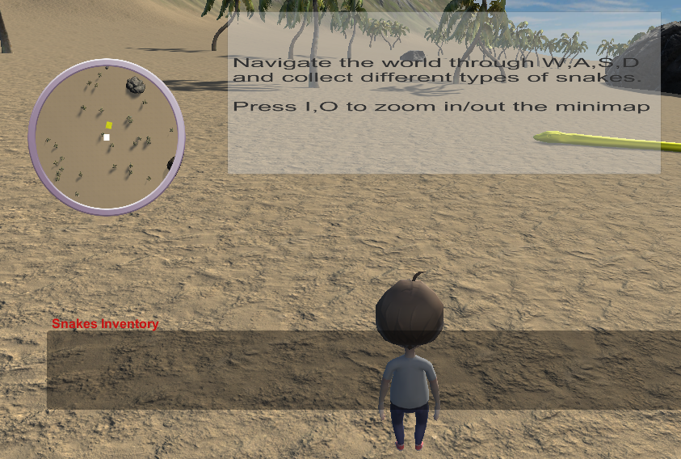
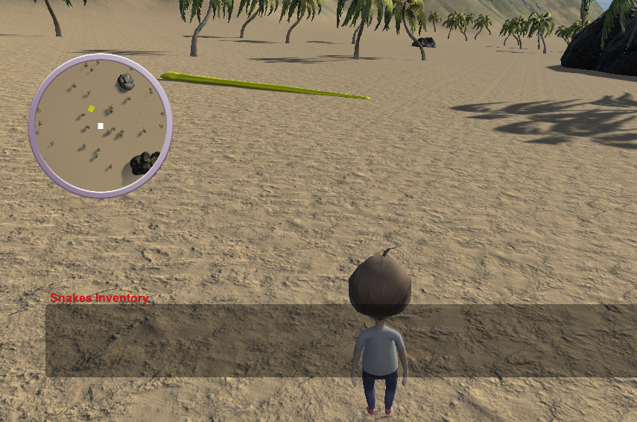
Play test report
Findings:
The game is playable now (lagging is not there anymore)
Player movements are now pleasant
Snake animations are good and funny looking
Snake indicator is really useful
Did not notice the minimap zoom in/out functionality before. Showing game instruction is good

Slide 3
Development progress
Final version(20th of May 2018):
Finally we fixed the lagging issue!!!
We re-created the snake model(s)
Added tutorial instructions to the GUI
Added some music
Added snake indications on map

